Slide 1
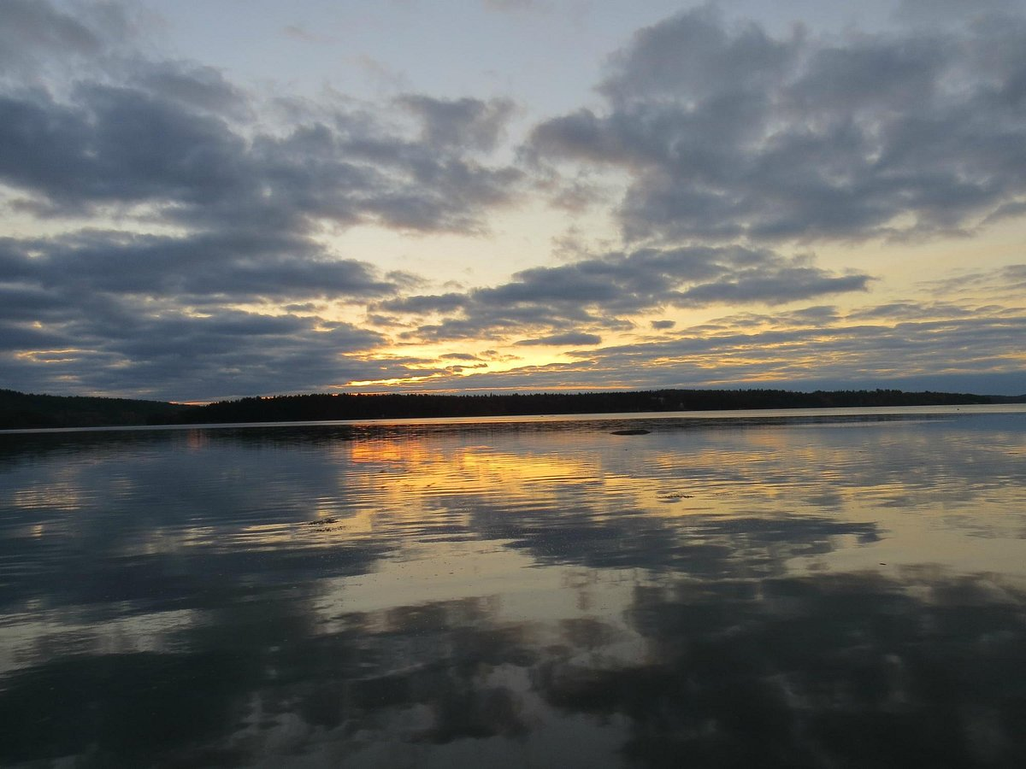
TOWN OF HANCOCK
COMPREHENSIVE PLAN UPDATE * FUTURE LAND USE
August 17, 2026 Public Discussion

Slide 2
AGENDA
Welcome & Objectives
Hancock Comprehensive Plan Overview
  Comprehensive Plan 101
  Public Engagement
  Vision
  Major Themes
  Future Land Use Plan
Next Steps
Public Discussion / Question & Answer

Slide 3
WELCOME
Hancock Comprehensive Planning Committee
Doug Kimmel
Ruth Franzius
Mary Turner
Patricia Kontur
Antonio Blasi
Chris Holmes
Renee Duncan
Brett Ciccotelli
Facilitator
Matt Williams, The Musson Group

Slide 4
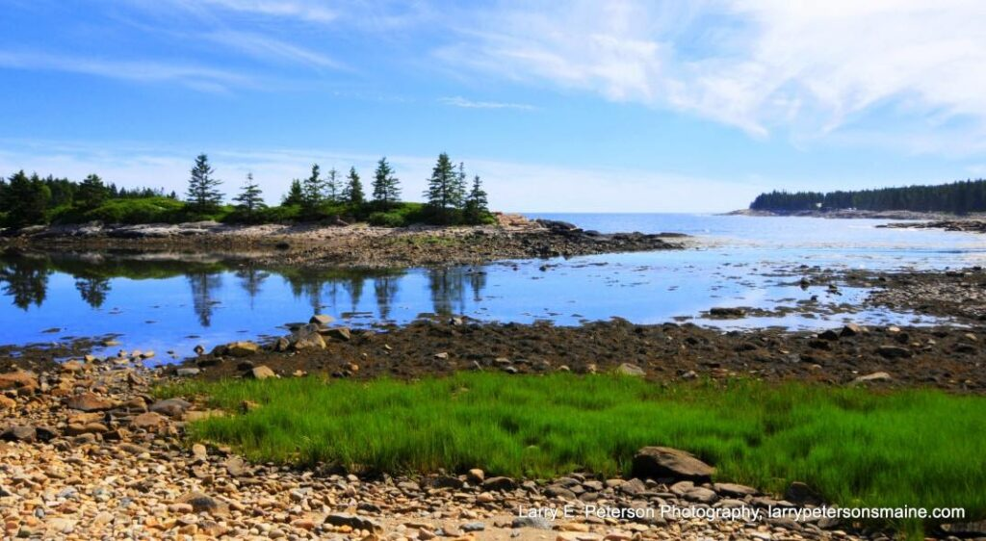
OBJECTIVES FOR TODAY
Provide an overview of the Hancock Comprehensive Plan Update process and product.
Review proposed Future Land Use plan
Answer questions & gather feedback

Slide 5
COMPREHENSIVE PLANS 101
WHAT
A shared vision of the future;
WHY
HOW
Data collection and analysis of change over time
Guides zoning and land use decisions, municipal budgeting and work plans
Guide to where and how growth happens
Public survey
Defined goals and strategies to support a strong, resilient community
State Mandated
Comprehensive Planning Committee guided by professional facilitator
Helps provide framework and support for state grant applications
Framework for maintaining local control
Analysis of change over time

Slide 6
PUBLIC ENGAGEMENT
During the Comprehensive Plan process there have been regular opportunities to collect public input.
Several public workshops have been held to discuss topics such as housing, recreation, etc.
A townwide survey collected responses from 230 residents. Major themes from survey responses included:
a. There is a need to encourage more multi-family housing units
b. Residents want more recreational opportunities, especially in relation to the shoreline and improvement to recreation facilities at the school.
c. Improving protections for natural resources should be a priority.
d. The Town should focus growth along Route 1, Route 182, and Washington Junction Road.
Monthly Committee meetings over nearly three years.

Slide 7
INVENTORY & ANALYSIS
Population & Demographics
Economy
Housing
Transportation
Public Facilities & Services
Recreation
Natural Resources
Agriculture & Forest Resources
Historic, Cultural & Archeological Resources
Existing & Future Land Use
Fiscal Capacity

Slide 8
A VISION FOR HANCOCK
The future of Hancock includes more residents, both seasonal and year-round, with more young families and a mixture of ages and households. The town embraces visitors throughout the summer season and welcomes businesses that provide amenities during this time. Hancock seeks to balance the bustle of its commercial throughfares with the privacy and quiet of its residential neighborhoods.
Hancock is rooted in tradition and history that keep the rural, coastal character of the town.
The natural environment of Hancock, with its pristine beauty and unique habitats, is central to Hancock’s identity. Preserving the existing landscape and stewarding it into the future are of the utmost importance to maintaining a clear vision for the town. Supporting conservation efforts and the expansion of recreational opportunities for residents and visitors will help Hancock flourish.

Slide 9
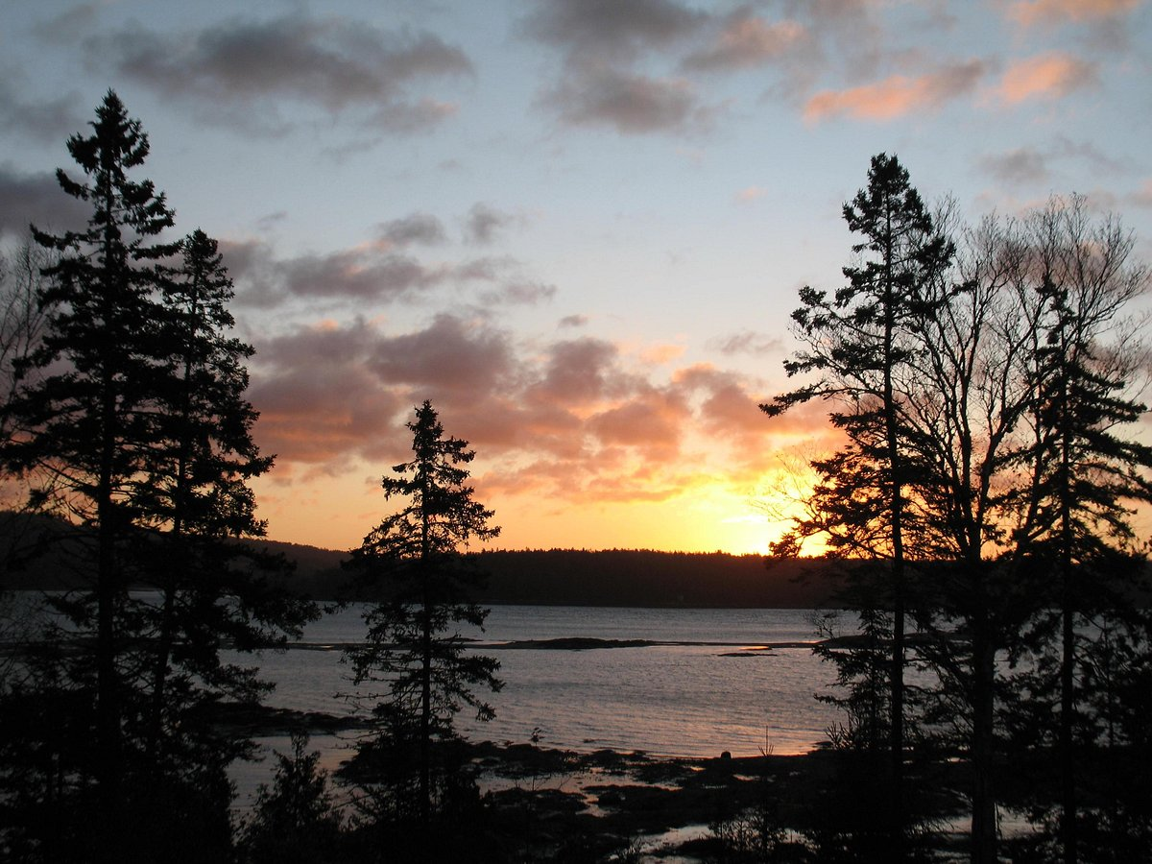
MAJOR THEMES
Provide affordable and attainable housing to people of all walks of life.
Protect and steward Hancock’s natural beauty, pristine environment, and scenic viewsheds.
Develop active transportation opportunities for residents and improve traffic safety.
Honor and preserve Hancock’s history, while allowing resilient growth to occur.
Maintain the rural and coastal character of Hancock.

Slide 10
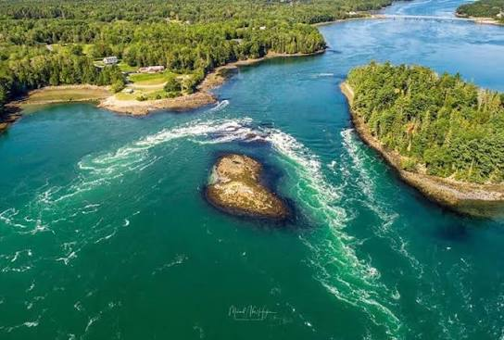
POLICIES & GOALS
Goals = the destination. Broad statements like "preserve rural character" or "ensure a range of housing choices." Not enforceable on their own, think of them as the town's stated values.
Policies = the commitments. Specific actions tied to each goal, like "update the zoning ordinance to allow accessory dwelling units" or "direct new growth to areas with existing infrastructure." These are the things town boards are expected to actually follow through on.
This is where comprehensive plans go from theory to actionable steps.

Slide 11
RECREATION AND OPEN SPACE
GOALS ACTIONS
Provide and maintain a diversity of resilient, high-quality recreational amenities and infrastructure for all ages and seasons that meet the needs of year-round residents, seasonal residents, and seasonal visitors.
Create and maintain at least one public access point for recreational uses such as swimming and kayaking.
Enhance existing cultural and community events within the Town of Hancock.
Work collaboratively with local and regional partners, especially land trusts, to enhance existing conserved recreation areas and provide public access.
Pursue opportunities, through public and private partnerships, to conserve important open space or recreational land.
Provide adequate resources to the Recreation Committee and Hancock Happenings Committee to be able to manage and facilitate local events.

Slide 12
ECONOMY
GOALS
Identify new locations for community services that support the idea of mixed-use centers identified in the future land use plan.
Diversify the local economy and increase economic resilience in the face of unknown climate and market changes. Support economic infrastructure for remote work and small business innovation, encouraging entrepreneurial growth and year-round employment.
Attract and retain working-age residents and young families by improving housing, education, and essential services.
ACTIONS
Consider the creation of an Economic Development Committee to conduct a study to assess economic risks (e.g., climate, housing, education gaps, over-reliance on tourism) and identify diversification opportunities. Provide funding support as needed.
Engage with the construction and building community to find out how the town can continue to support them as regional employers.
Explore funding, marketing, and regional collaboration opportunities that support retention of young families (e.g. childcare, educational, and youth programs).

Slide 13
HOUSING
GOALS
Construction of additional housing units to address unmet demand arising from a growing economy, particularly housing
that supports the year-round and seasonal workforce.
Housing types that meet a variety of needs and demographics (e.g. seniors looking to downsize, young families starting out, year- round and seasonal workers, multi-family apartments).
A mixture of housing price points that serves people with average and lower income levels, with a focus on the construction of affordable and attainable housing units.
Land use and zoning policies that encourage the development of quality affordable housing, including long-term rental housing, and balance the need for seasonal and year-round homes.
ACTIONS
Explore incentives and/or requirements for housing developers to set aside land for affordable housing or include affordable units in their projects.
Investigate impacts of Short-term Rentals (STRs) on the local community and housing market.

Slide 14
NATURAL, WATER, AND MARINE RESOURCES
GOALS ACTIONS
Emphasize sustainability as an underlying principle in natural resources, forest resources, and water resources policies and management.
Coordinate with area institutions, organizations, agencies, and major landowners to pursue shared natural resources conservation and protection goals. Consider joint applications for state grant funding when possible.
Protect scenic resources.
To protect, maintain and, where warranted, improve physical and visual public access to the community’s marine resources for all appropriate uses including fishing, recreation, and tourism.
Consider visual impacts of large-scale and small-scale developments on existing scenic resources and character of Hancock. Identify design strategies and tools to mitigate impacts on those resources.
Continue to monitor/maintain older subsurface sewage disposal systems.
Work with local property owners, land trusts, and others to protect major points of physical and visual access to coastal waters, especially along public ways and in public parks.

Slide 15
PUBLIC FACILITIES
GOALS
Support local healthcare services.
Offer high-quality education for Hancock students.
Efficiently meet public facility and service needs.
Invest in and maintain public facilities and services that promote and support growth and development in identified growth areas.
ACTIONS
Renovate and improve the Town Office.
Ensure long-term educational stability and continue to communicate with the state for funding of a new grammar school.
Work with communication providers to assure that the town residents, businesses, and guests have affordable and reliable access to high-speed internet.
Identify any capital improvements needed to maintain or upgrade public services to accommodate the community’s anticipated population change and changing demographics.

Slide 16
TRANSPORTATION
GOALS ACTIONS
A safe and efficient road network that is •
well-maintained throughout the year.
Work collaboratively with MaineDOT to recognize the impact of Route 1 on the community and address safety and accessibility concerns stemming from its presence.
Close communication and coordination with MaineDOT, local, and regional partners.
Collaborative partnerships that continue and increase multi-modal transportation options that are accessible for all users.
A well-maintained, safely interconnected, and growing trail network.
Motorized and non-motorized transportation infrastructure that meets the diverse transportation needs of residents (including children, the elderly and disabled) and through-travelers.
Partner with MaineDOT to enter into a Village Partnership Initiative agreement for planning around the village center near the Village Green.
Discuss options for expanding public transportation, especially for the aging community.
Develop a list of high-priority pedestrian and non-motorized connectivity points, especially for safer crossing of Route 1.

Slide 17
HISTORIC & CULTURAL RESOURCES
GOALS
Protect and interpret to the greatest extent practicable the significant historic and archaeological resources in the community.
Cultivate collaboration and partnerships regarding protection and interpretation of cultural and archaeological resources.
ACTIONS
Cooperate in any efforts by the local historical society and/or the Maine Historic Preservation Commission to assess the need for a survey of the community’s historic and archaeological resources.
Develop a list of key ideas for historical, cultural, and interpretative information around town.

Slide 18
FISCAL CAPACITY
GOALS
Finance existing and future facilities and services in a cost-effective manner.
Create cost-effective partnerships for facilities and services that serve the town as well as the surrounding region.
Fund capital investments through various sources, including grants, partnerships, and local taxes.
Encourage a culture of inclusion and transparency in municipal financial decision-making.
ACTIONS
Assess town properties (including improved facilities) and develop a Capital Maintenance Plan that enables the town to adequately plan for future capital improvements.
Continue to pursue opportunities for collaboration with regional partners and neighboring communities to provide programming and mutual aid support
Explore grants available to assist in the funding of capital investments within the community.

Slide 19
FUTURE LAND USE

Slide 20
FUTURE LAND USE
GOALS
Opportunities for those who want to live and promote business in Hancock.
Land use policies that enable development of spaces and infrastructure for needed community services.
Efficient and effective permitting procedures, especially in growth areas.
Protected spaces for present and future recreational opportunities.
Preserving critical rural areas from the impacts of development.
ACTIONS
Consider land use policy decisions that could create additional housing opportunities to address housing shortages (e.g., affordable housing, multi-family housing).
Create a growth area where the potential density of housing will not be a burden on the community and gives people access to services/jobs in Ellsworth.
Create a village area that can support commercial development and public services but may not be suitable for greater density of housing at this time.

Slide 21
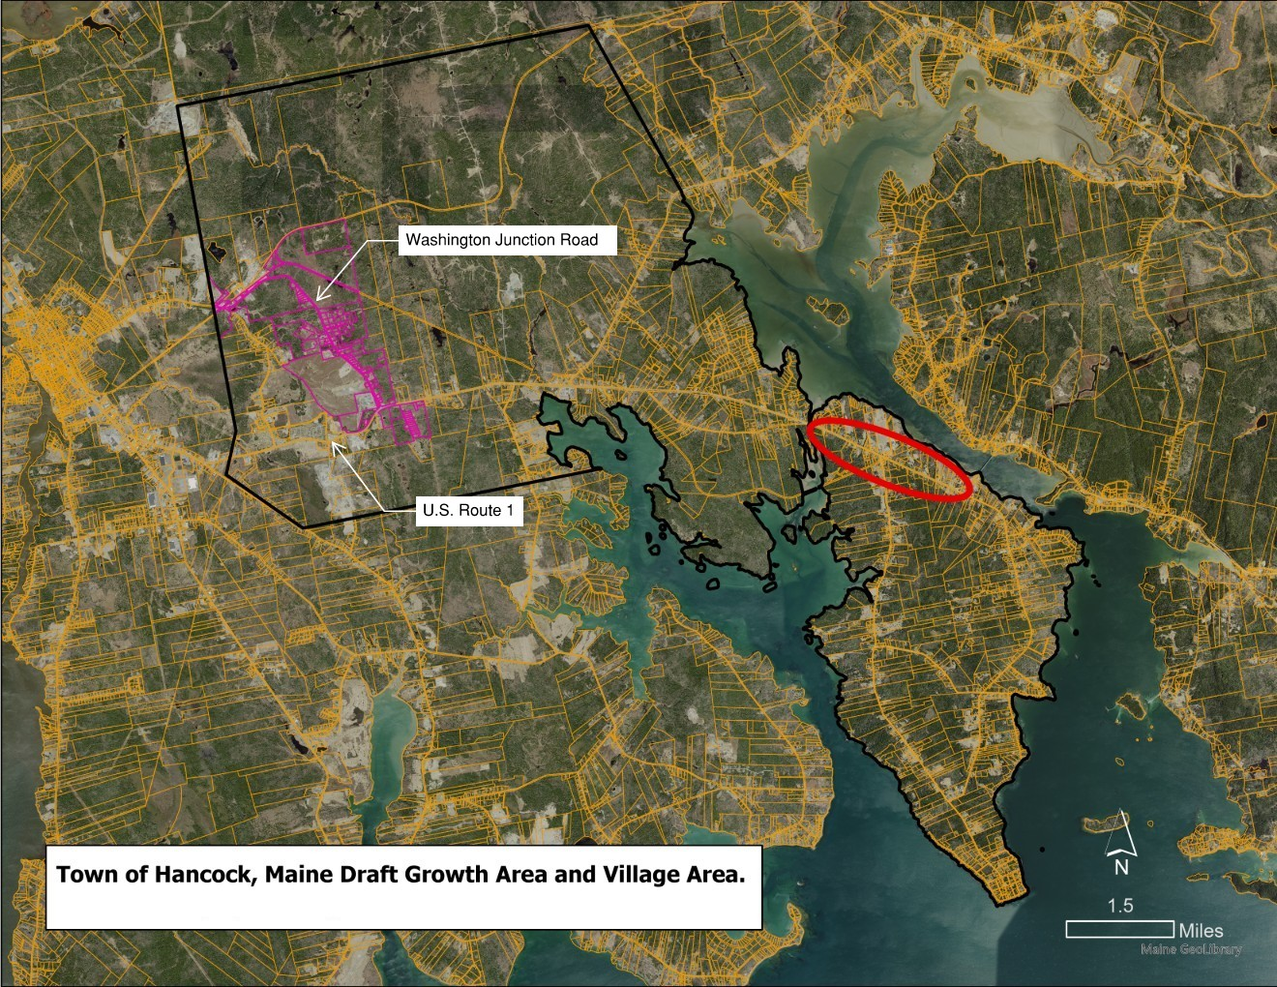
FUTURE LAND USE MAP

Slide 22
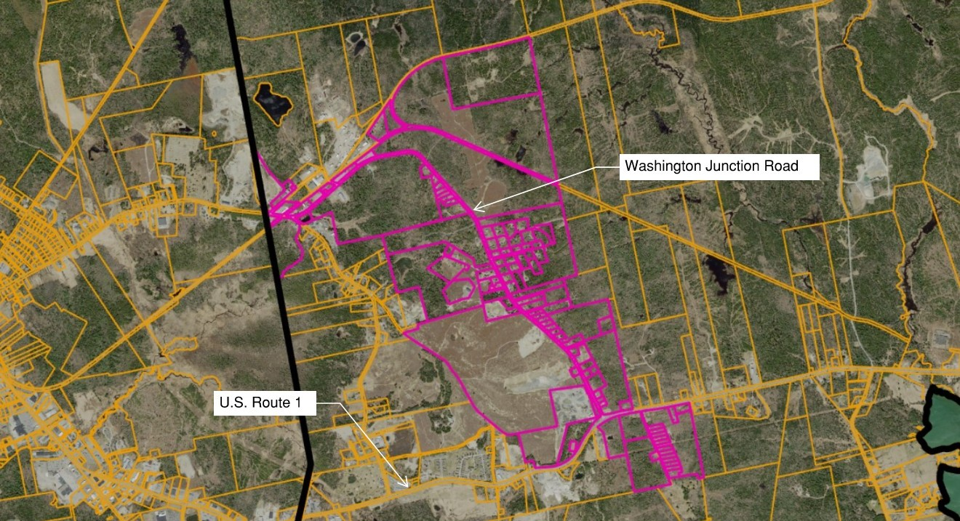
FUTURE LAND USE MAP
Notes:
Add labels for Washington Junction Road and Route 1

Slide 23
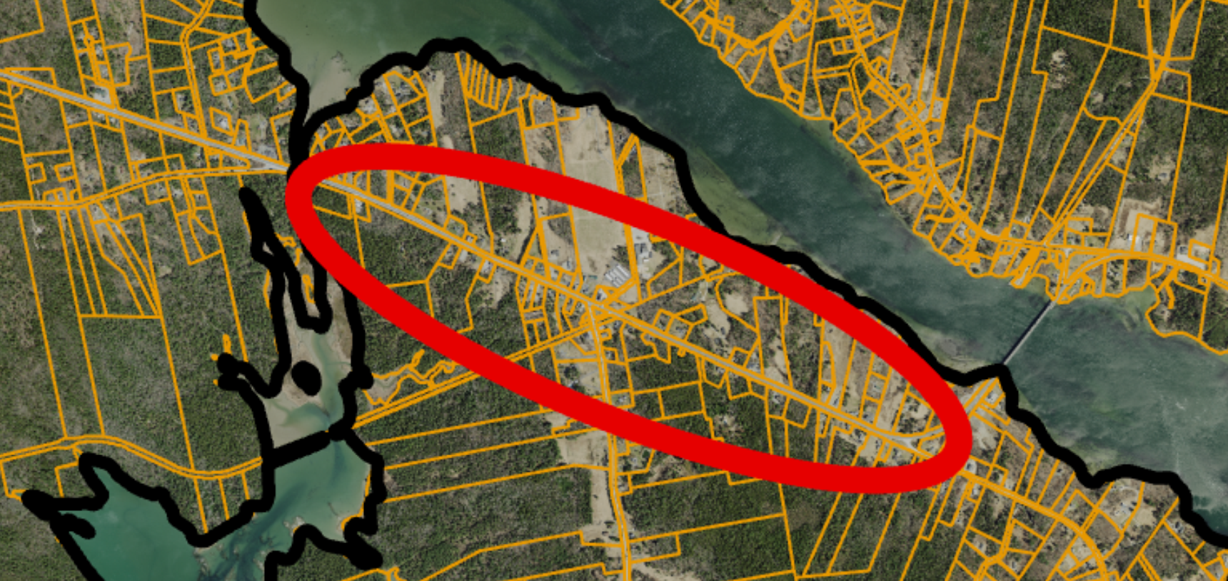
AREAS FOR FUTURE STUDY
FUTURE LAND USE
The village area shown is general and meant to prompt thinking about future opportunities.
HANCOCK VILLAGE AREA
Emphasis: A mix of commercial, public, and residential uses that are not ready for growth area status due to safety concerns along Route 1.

Slide 24
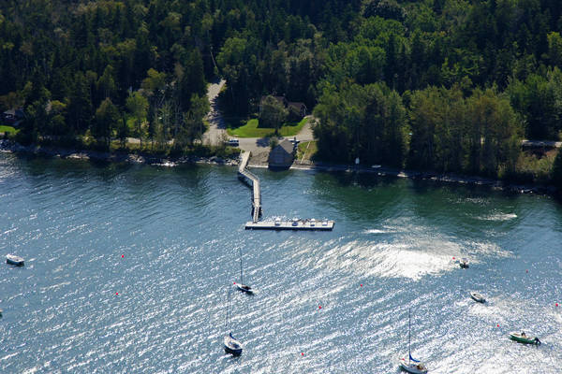
NEXT STEPS
Committee to collect feedback and review, make revisions
Submit proposed draft to the State of Maine for review and approval
Revisions as needed based on State of Maine feedback
Presentation of final draft to the Selectboard
Schedule special town meeting for approval of plan

Slide 25
PUBLIC DISCUSSION / Q&A

Slide 26
THANK YOU!

